Slide 1
RIFKI MUH ARBIAN
BUSINESS INTELLIGENCE
CASE STUDY #3
dibimbing.id

Slide 2

RIFKI MUH ARBIAN
About me
Introduction
I’m a Student in Business Intelligence Bootcamp Batch 9 at Dibimbing.id. this is my mini project. Ill be using a tool DBEaver to ETL (Extract, Transform, and Load) for data table to make some insight data, when i working as an BI Analyst in Bank BRI.

Slide 3
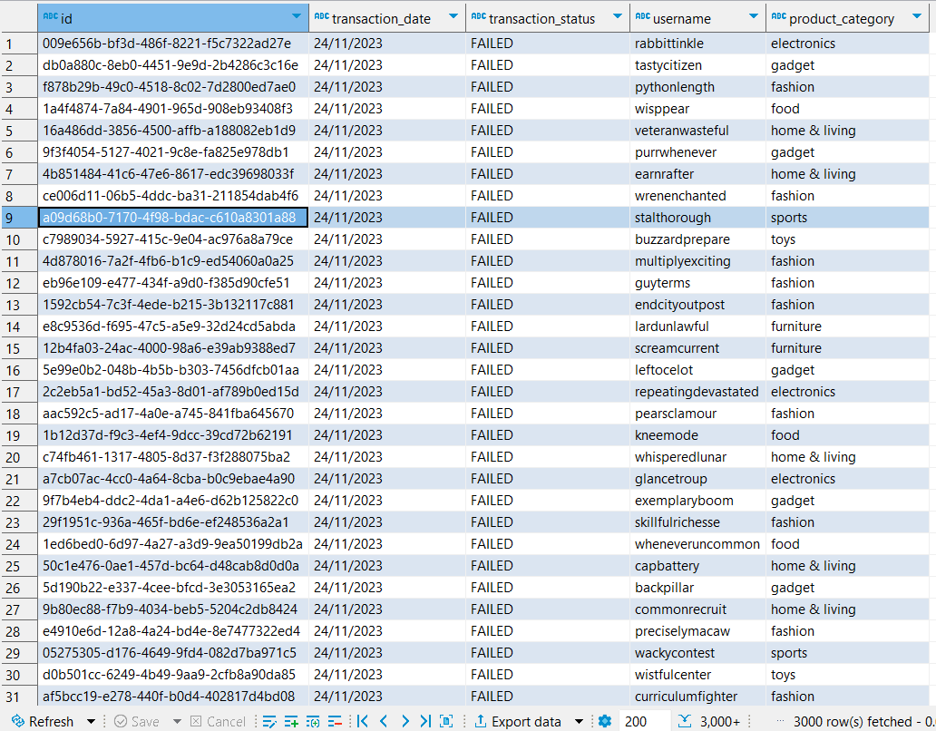
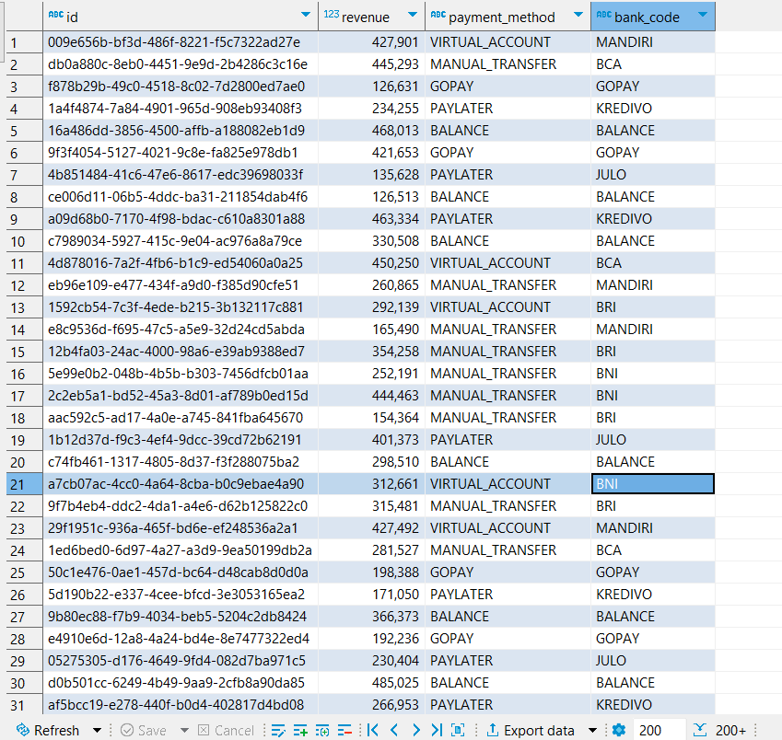
All the data table below that need to ETL (Extract, Transform, and Load). Thus, I could make some insight data:

Slide 4
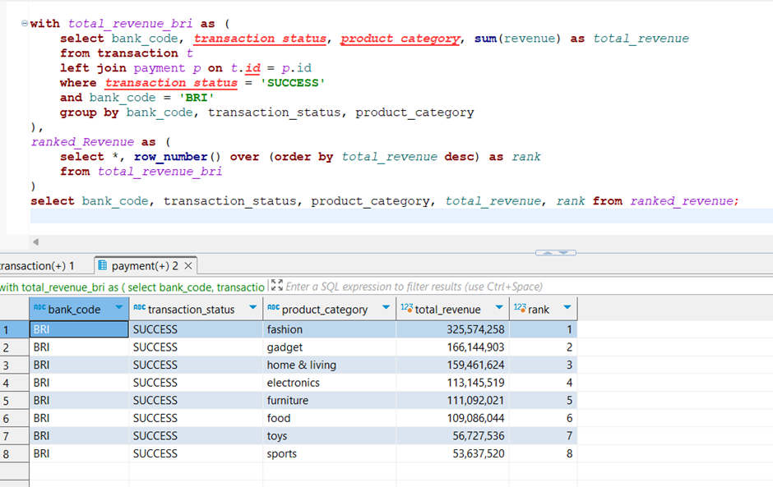

I am a BI Analysis Worker at BRI Bank. Here, as a BI analyst, I want to formulate a comprehensive list of revenue from the transaction and payment table that have occurred in the TokoPakdio app for transactions using Bank BRI and transaction status is succeed.
So this is the result after filtering data from both the transaction table and the payment table.

Slide 5
From here, we can see the results, that there are 8 product categories including Electronics, Toys, Fashion, Sports, Food, Furniture, Gadget, and Home & Living. From these categories, it has been filtered and sorted that the highest total revenue is in Fashion, followed by Gadget, Home & Living, Electronics, Furniture, Food, Toys, and lastly, Sports.
Not stopping there, we can further elaborate by including the Payment Method column because for transactions using BRI Bank, there are 2 applicable payment methods: Manual Transfer and Virtual Account.
like this

Slide 6
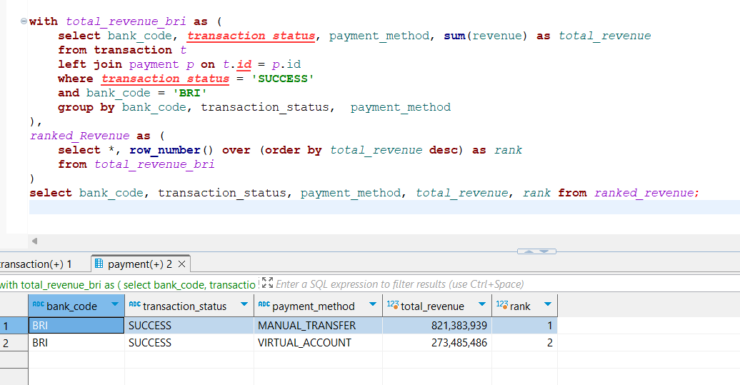

Slide 7

The result from all transactions allows us to conclude that the highest total revenue is held by Manual Transfer compared to transactions using Virtual Account.
OR

Slide 8
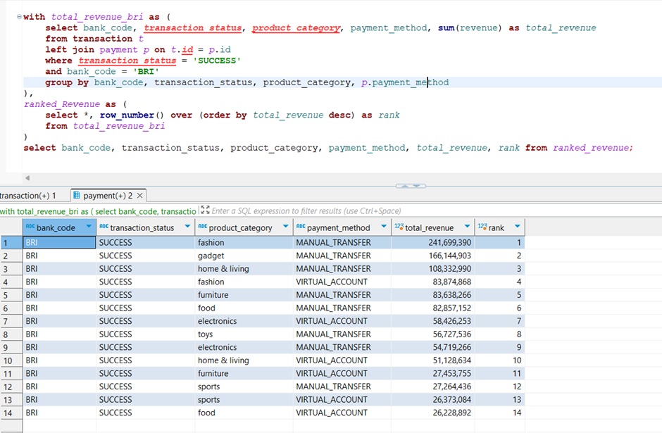

Slide 9
The result, as indicated in the previous slide, shows that the highest revenue is still held by the Fashion product category, with payments made through Manual Transfer.

Slide 10
Conclusion
Based on the analysis results, it is found that from the Payment table and Transaction table data in TokoPakdio, for successful transactions using BRI Bank payments, the product category with the highest total revenue is Fashion, followed by Gadget, Home & Living, Electronics, Furniture, Food, Toys, and lastly, Sports. Additionally, the analysis concludes that the highest total revenue is held by Manual Transfer compared to transactions using Virtual Account.

Slide 11

That is my mini project
https://www.linkedin.com/in/rifkimuharbian99/

